Slide 1
Group Leaders 19/20
Sport Specific Session

Slide 2
The Activities Team + Social Media
Kayleigh McNeice
Sports Development Coordinator
Joe Ross-Nelson
Societies Coordinator
Priya Pabla
Academic Communities Coordinator
Onyinye Nkemdirim
Student Activities Manager
A simple follow, like or retweet can really help us build our social media platforms which in turn attract more sponsorship and support
@TeamGreenwichGSU
@GSU_team

Slide 3
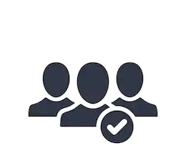
Memberships
Building and keeping your members
Welcome fair – be approachable, friendly and know what your offer is to students
Trials – be organised, advertise early and ensure non-competitive offer is advertised
GSU Website – make sure page is up to date and looks appealing to students
Social Media - have active social media accounts, engage with GSU and your members through these
Social events – events away from competitions, friendly social events
How else do you think you can gain new members and keep both new and old members participating throughout the year?
Paying Memberships
Membership fees include:
• Training
• Venue Hire
• Transport
• Umpires
• Kit
• Insurance
• Equipment
Sport Format | Cost
BUCS/Competitive | £60
LUSL/Recreational | £40
Social | £20

Slide 4
Fixtures
All LUSL and BUCS fixtures compiled into 1 spreadsheet and sent over on Thursdays for following week
Any missing info can be checked by teams online
Transport is booked if destination is over 1hr 30mins away - unless the team express they want to use the mini bus and members of team have relevant training
48 hours notice to rearrange or cancel a fixture - If less than 48 hours notice for reasons other than bad weather your team will be liable for any costs incurred by your opposition and you will automatically concede a walkover
You cannot request a walkover until 3 other dates have been discussed with opposition

Slide 5
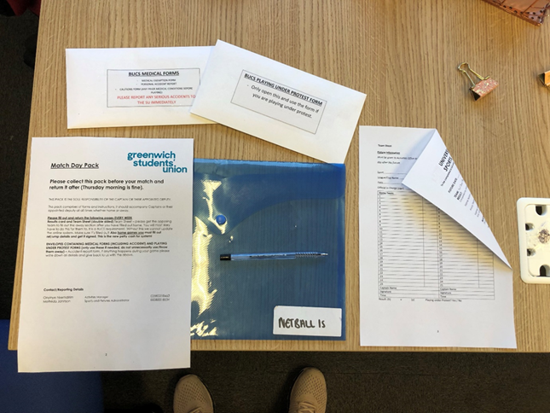
Match day procedures
Match packs can be collected from Avery Hill office on Wednesdays
Match official money organised and ready for collection on Wednesdays or Fridays for weekend fixtures – receipt must be returned or no ref money will be given out the following week
Match packs and receipts must be returned by Friday lunchtime to Avery Hill office
Captains will be sent coach info by Tuesday latest prior to fixture (driver number and registration)
Refer to pack to determine pick up location

Slide 6
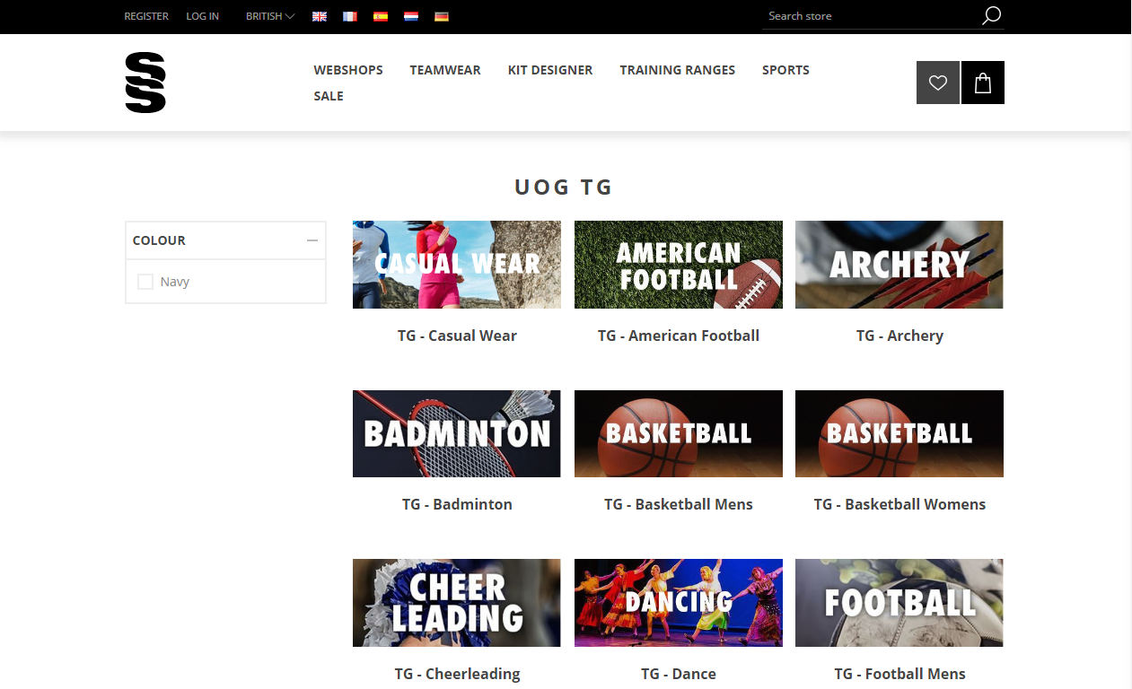
Equipment & Kit
What do you need?
Do you know how many kits you have from last year?
Use sheet in your packs to identify what you might need for next season
Ensure if you require new equipment you request enough in your funding breakdown
All teams except new clubs and Men’s football will not get new kit unless brought through generated account
Teamwear and casual wear can be purchased from Surridge Sport
A new process for collecting kit/equipment will begin at the start of next season - TBC

Slide 7
Trials
Trials/Taster Sessions
How are you planning on conducting your trails/taster sessions?
Inclusive
Organised
Professional
Informative
Fun
Fair
Challenging
Welcoming Ongoing

Slide 8
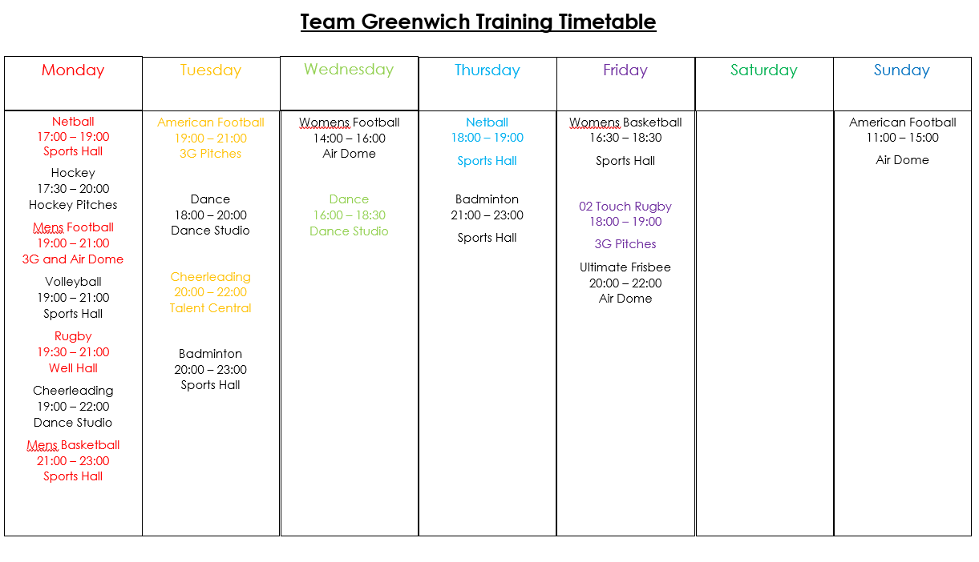
Training
Current Training Timetable
1 session per club initially
After allocation, spare sessions will be distributed on a needs basis
Refer to packs to put forward any requests to change preferred training day – 1, 2, 3
This is just a preference/request and does not guarantee you the slot. The info will be collated and we will decide final training times, but will do our best to suit each team
How can you ensure you get as many team members as possible to training?

Slide 9
Committee Roles & Responsibilities
Core roles essential to each committee
Chair/President
Oversees all of the group’s activity
Provide support, advice and guidance to other committee members
Actively represent the group members in a variety of situations
Highly organised and committed to your group
Not afraid to delegate
Decision maker
Secretary/Vice Chair or President
Backbone of any student group
Deals with paperwork and records to ensure everything runs smoothly
Emails needs to be written, agendas and records of meetings created and distributed
Communicate between group leaders and members to ensure everyone knows what’s happening
Help keep members interested and involved
Take on chair/president role when they are absent
Treasurer
Compulsory for 19/20
Key committee member with the responsibility of the clubs finances
Must sign off on all claim forms produced by the club
To oversee the financial side of all club activities, such as social events and fundraising events
To oversee the management of any membership funds that are payable to the club
Captain
Responsible for having the team on the pitch at all fixtures
Make sure teams arrive at their matches and that training is what the team need
Select the squad for each fixture and ensure players are eligible to play
If club has multiple teams the captain of each team is responsible for the match pack

Slide 10
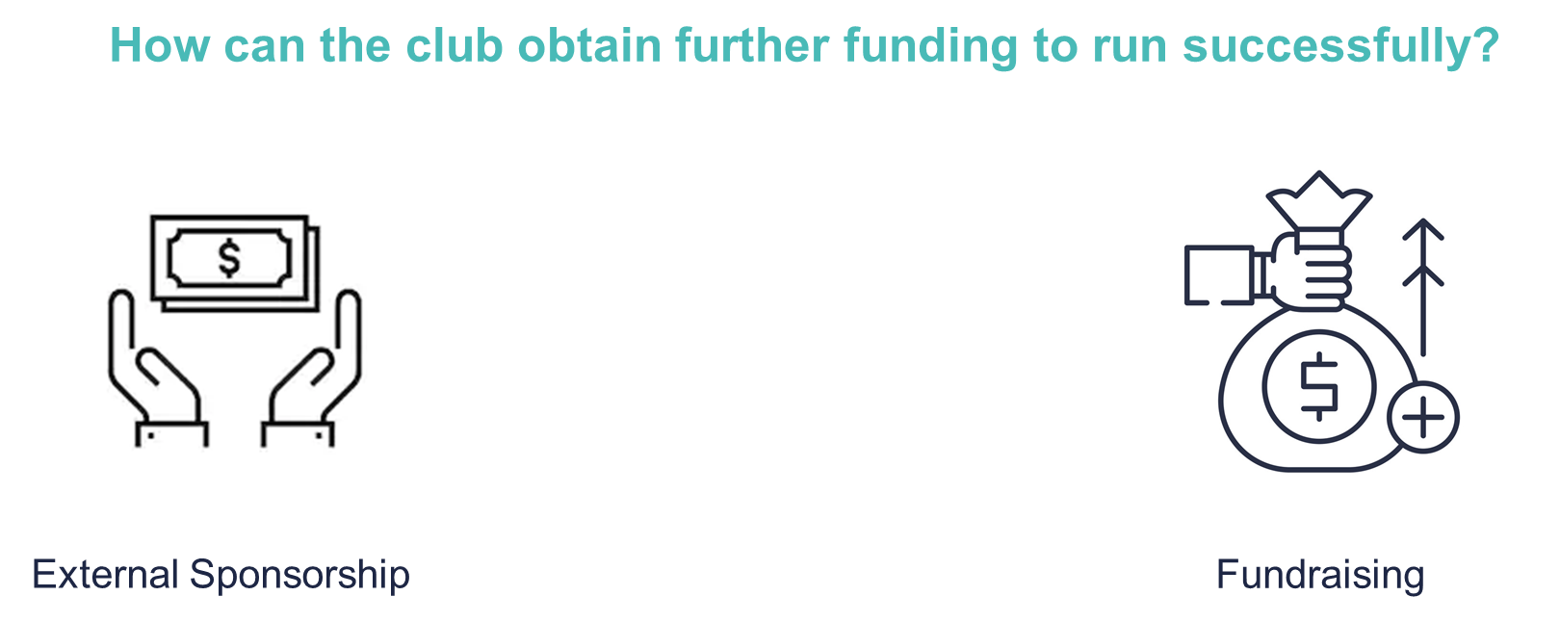
Budgets and Funding
Club Income
+
SU Sponsorship
Membership Income
Amount needed to run your Club
=
Budget Breakdown
SU Sponsorship must be bid for (see packs)
All essential requirements for club taken from this: equipment, match officials, transport, coaches etc
Membership money also contributes to your overall club income
Take a look at budget forms, a meeting after this training will be organised to fill out budget forms
Speak to committee members and discuss what changes if any need to be made to your budget planning forms

Slide 11
Risk Assessments
GREAT NEWS!!!
A number of regular activities have already been risk assessed:
Room Bookings (where activity fits primary room purpose)
Stalls
Bake Sales (though, you still need to provide allergy info)
Sports Fixtures/Training
PLUS – over the Summer, we’re working on creating a wide-range of templates to make things even more straightforward for you!
Greenwich Students’ Union is a registered charity.
As part of that, even though our Sports Clubs and Societies are student-led, they are still GSU’s legal responsibility!
As such, it is essential that the risk attached to our activities is managed as thoroughly as possible.
Simply put… a Risk Assessment is a careful examination of what could cause harm to people, so that you can weigh up whether you have taken enough precaution to prevent it from happening.

Slide 12
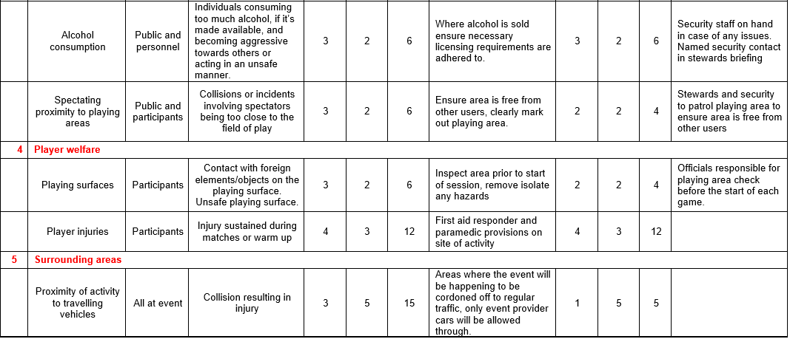
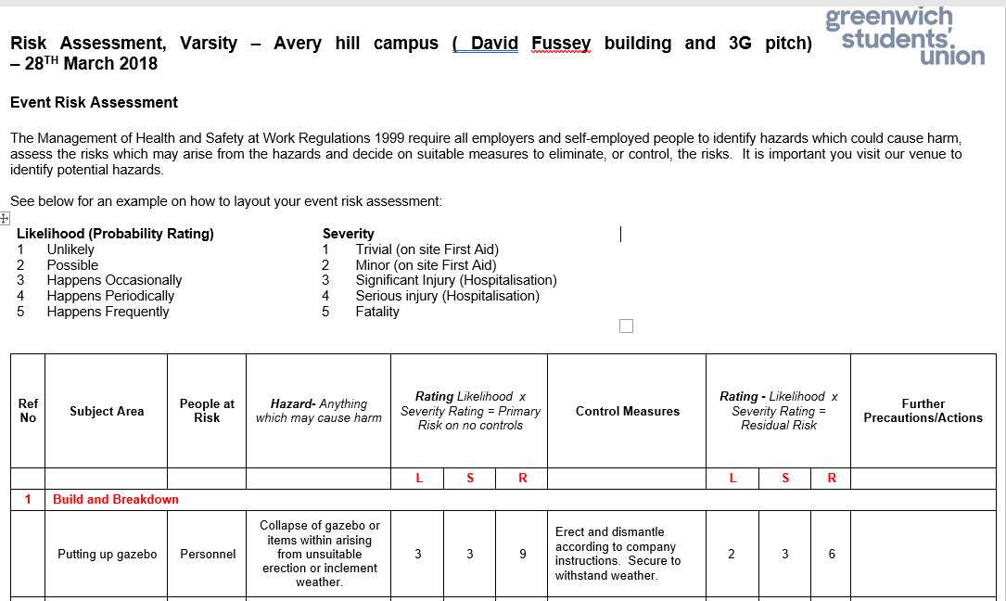
Risk Assessments

Slide 13
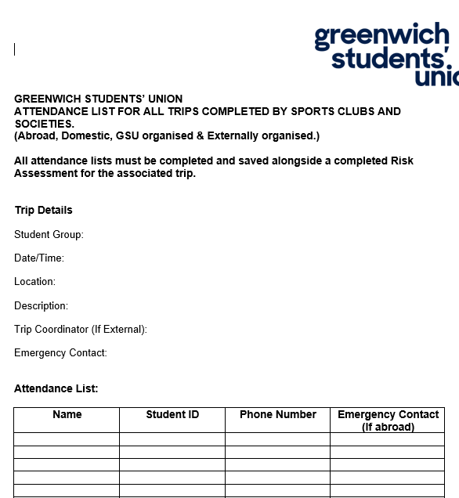
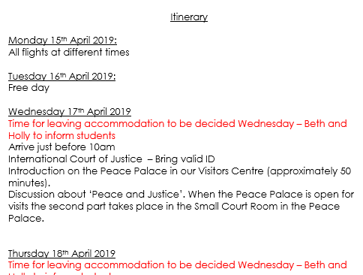
Risk Assessments
TRIP ATTENDANCE LIST
ITINERARY

Slide 14
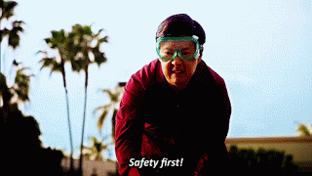
Risk Assessments
In the meantime, how can I ensure my sports club is risk assessed?
Events with alcohol consumption
The consumption of alcohol can be a high-risk activity, and a contributing factor to many medical emergencies, ill-behaviour and damage.
If you are organising an event where alcohol is provided, you must mention this in your Risk Assessment, and inform us accordingly.
To ensure damage is limited, a member(s) of the committee should place themselves in a responsible (sober) position throughout the event.
Please remember, that at no time should a student feel pressurised into drinking – allegations of such behaviour at a sports-organized event may result in disciplinary actions.
Let’s not forget, not all members of your group will consume alcohol – a lot of UoG Students don’t - and many more will not do so in excess.
Holding alcoholic socials is totally fine, but be mindful that consistently doing this can be rather off-putting for students.
And once again, alcohol will not be funded from a Sports Club own funding.
Some H&S Top Tips:
Send your risk assessment to participants in advance
Provide an induction to novice members
Put a set of rules/guidelines in place
Review your Activities & RAs regularly
If you’re unsure, google it.
If google can’t help, ask us!!

Slide 15
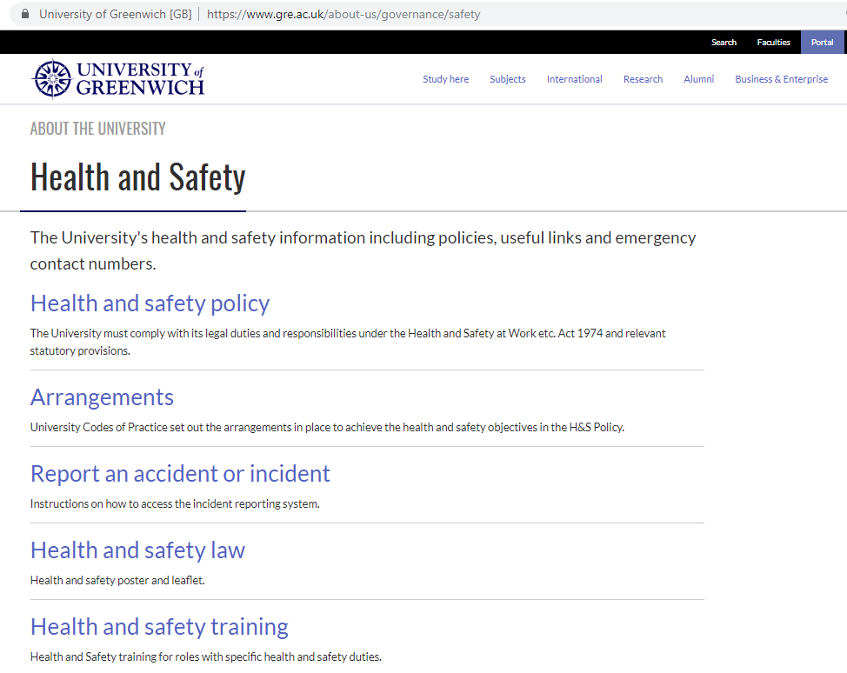
Risk Assessments
In the event something goes wrong, please make sure to:
Let us know!
Report it via the Student Portal on the UoG Website!!!
https://www.gre.ac.uk/about-us/governance/safety

Slide 16
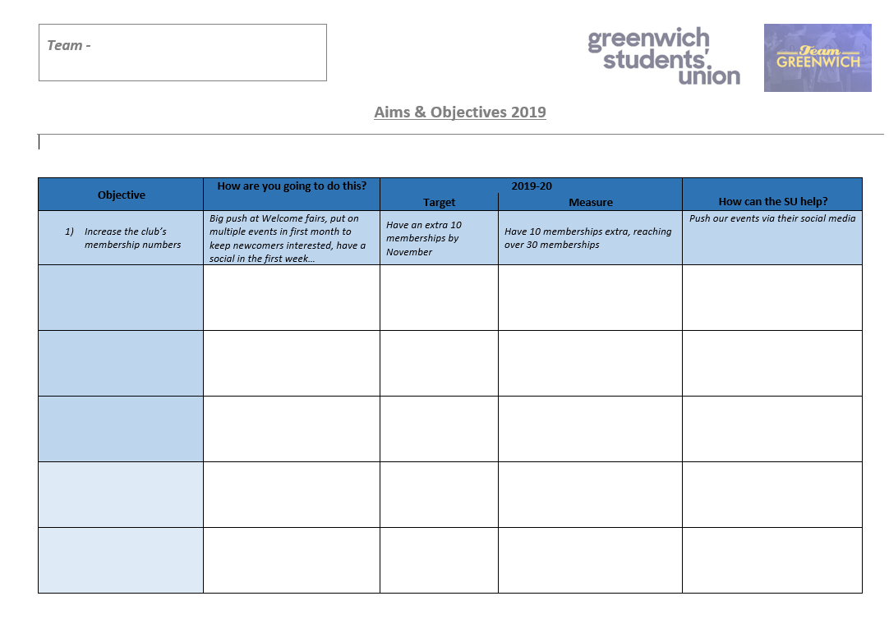
Year Plan – Aims & Objectives
Please refer to resource pack for the below document

Slide 17
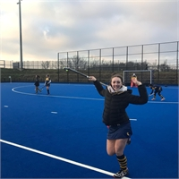
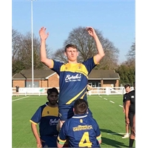
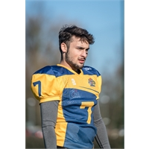
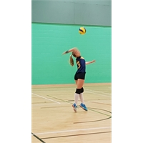
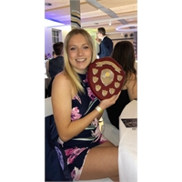
Sports Exec
Your new Sports Exec for 2019/2020
Emma Caney
Nicholas Jones
Jamie Martin
Guilia Terragni
Tia Walby
What is their role?

