Slide 1
Sponsorship & Fundraising
Group Leaders’ Conference 2019

Slide 2


Session Plan
Looking for sponsorship
Valuing your ‘organisation’
Future-planning
Sponsorship protocol
QUESTIONS

Slide 3

Looking for Sponsorship

Slide 4

Looking for Sponsorship
What is Sponsorship?
Sponsorships are a great way to raise some funds, and to present new opportunities to your members. They can help with:
  Financial income
  Attracting members
  Raising your profile
  Career prospects
Sponsors can be for a single event, an academic year, or a few years.
Ultimately, they can be hard work, but they’re worth it.

Slide 5
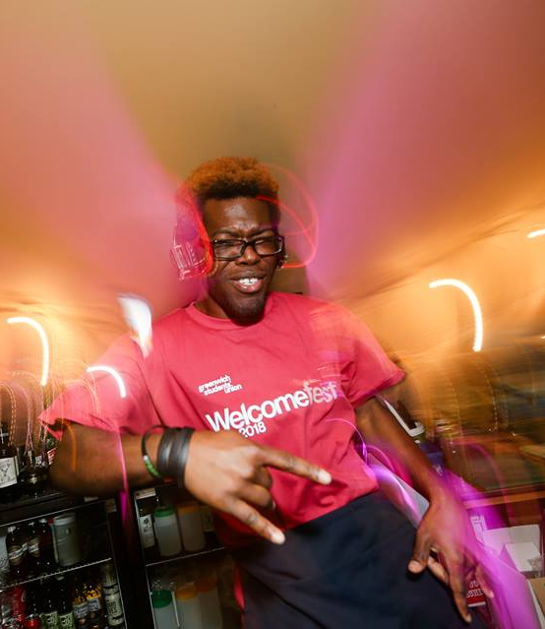
Looking for Sponsorship
What to look for in a sponsorship?
Finding who to approach can be a real challenge.
Try to identify your group’s USP, and this might help to narrow it down.
Identify what it is that you ACTUALLY want from a sponsor. Be specific.
Think about the long-term impact a sponsor can have.
Don’t overlook your connections. It’s always worthwhile asking friends and family about organisations they are associated with.
Possible places/business to explore for sponsorship:
Local Businesses/Franchises
Graduate Recruiters
Sporting Organisations
Restaurants
Bars & Nightclubs
Clothing Providers
It is important to note, that GSU might not approve sponsorships that risk bringing the organisation into disrepute.
A few No-Go’s to avoid:
Direct competitors with current sponsors
Betting/Gambling establishments
Money lenders
Tobacco / Cigarette companies

Slide 6

Valuing your ‘organisation’
Think of your Student Group as a Family Business.
It is an organisation that needs to be carefully looked after, but any value-added generates a great-deal more output.
As student groups of Greenwich Students’ Union, you have a brand that you can sell, a pre-established customer/client base of 20,000+ young adults, connections to influential institutions, and your members are a valuable commodity to businesses and recruiters.

Slide 7

Valuing your Organisation
Establish your worth
After contacting a potential sponsor, you need to gather evidence as to why your group is worthy of investment. Create a proposal they can’t refuse.
Key facts and figures
The story behind the group
Past successes
Example promo
Photos from events
Future plans
Common aims & objectives
2) Develop your proposal
It is vital that you explain to your sponsor exactly what they can expect to get out of the arrangement. Sadly, people rarely give away money for nothing.
Many companies will seek to advertise to students in exchange for your sponsorship… explain why your group presents a brilliant opportunity. Exposure at events is typically a great way to their heart.
Don’t be vague in your discussions – it is dangerous to risk misleading your sponsorship. Equally, be sure not to promise anything you can’t provide.
3) Highlight your expectations
Be explicit in what you hope to get out of your sponsorship.
Explain exactly how any funding/equipment/tickets/discounts etc. will benefit your society and it’s members. Your sponsor will want a full picture of what their contribution will go towards.
Provide specifics of how you will measure and recognise the success/impact of their investment. For example, an increase in memberships, a greater number of events, or a more diverse range of students involved.

Slide 8

Get a Contract.
Get a contract
Get it signed by the Sponsor AND the SU
Get 3 copies (you, sponsor, SU)
We will not raise an invoice to receive any funding without a contract.

Slide 9
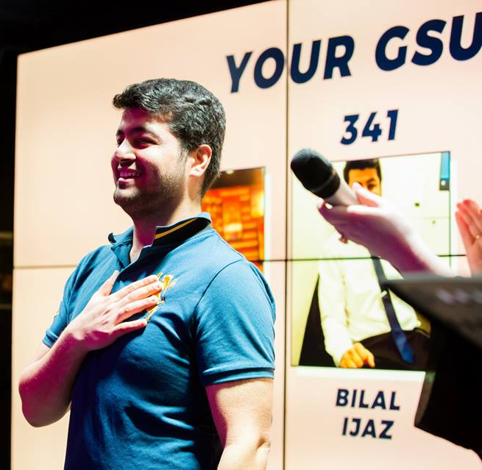
Future-Planning

Slide 10

Future-Planning
Sponsorships can help bring long-term success to your Group, so a positive relationship is essential.
Thank your sponsor personally, straight away
Send them email updates each term (purchases, facts/figures, successes)
Invite them to your events, and send them your promo
Meet with them to review the contract at the end of the year
Make sure they’ve held up their end of the bargain
Introduce them to your next committee
Keep us in the know.

Slide 11

Future-Planning

