Slide 1
Societies-Specific Training
Group Leaders’ Conference 2019

Slide 2
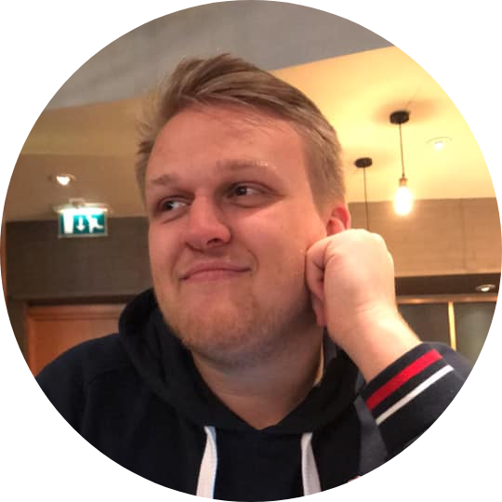
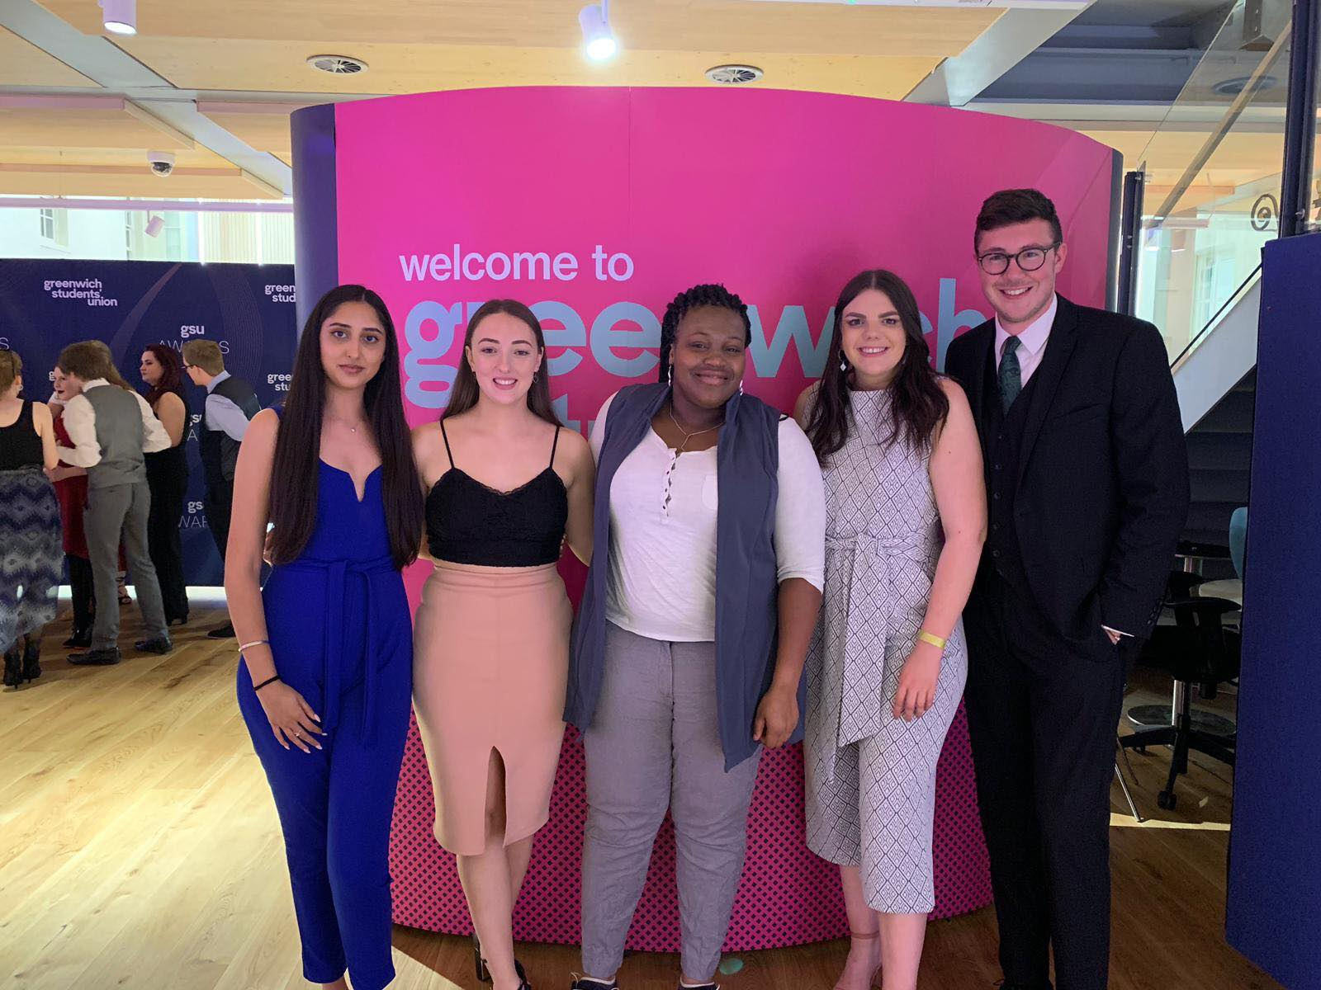
An Intro to GSU Societies
Societies are...
student-led, membership communities, which focus on common goals, share common interests and provide awesome skill-gaining opportunities.

Slide 3
An Intro to GSU Societies
Some fun facts & figures (well, I think they’re fun)
Over 100 Societies!!!! YAASSSSSSS!!
33 New Societies – of which 16 were new Academic groups!!!
4500 approx. Society Members (over 7000 including automatic memberships)
57 Meet & Greets in Welcome 2018
120 student group stalls across our Welcome Fairs
Over 300 Society Events this year alone!
156 Academic Society events
£2840.85 accessed through the Societies Development Fund
£8000 spent on our Academic Communities

Slide 4
An Intro to GSU Societies
Why are Societies important? (Joe’s answers)
Societies are...
Skill-gaining avenues
Extra-curricular opportunities
Second-homes
Valuable, diverse communities
Wellbeing boosters
Brand new experiences
CV-builders
Powerful statements
OG influencers
FRICKIN’ FUN!

Slide 5
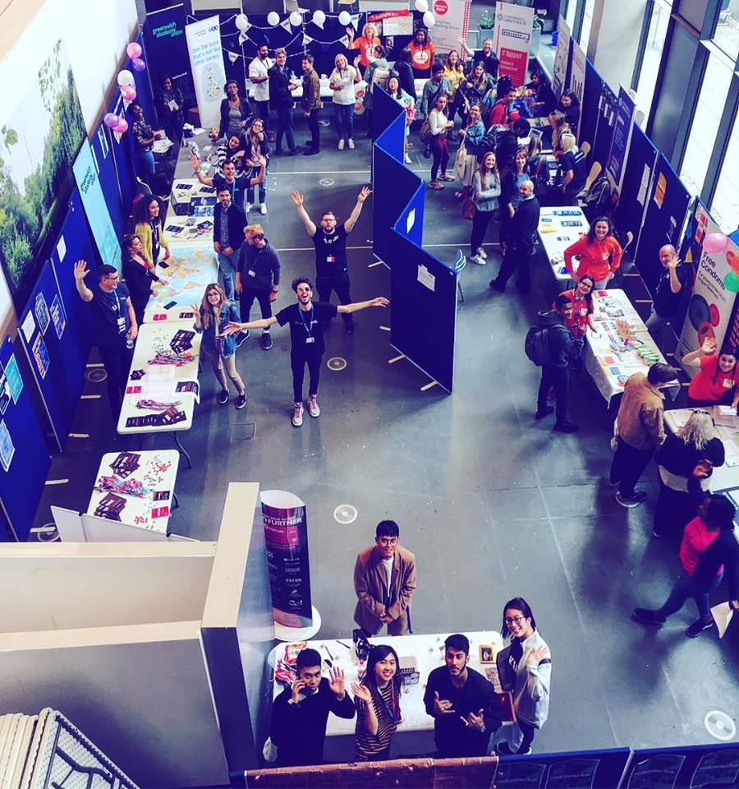
The Role of a Committee

Slide 6
The Role of a Committee
What does a Committee look like?
Notes:
Basically, a committee can look almost anyway you want it to. Play to your society’s strengths and needs. If a member has expertise that can be used by committee, create a role that suits them best. If you want to organise a trip every month, consider appointing a Trip Sec. Key things – must have 3 committee members minimum. Must have a president/chair/emperor, and a treasurer.
MUST MUST MUST MUST ALL PAY MEMBERSHIP.

Slide 7
The Role of a Committee
Compulsory role – no ifs/buts (education cuts)
Manage the money
Track expenditure and income
Establish budget and targets
Senior signatory on all claim forms, invoices and purchases
Ensure the Society breaks even
Representative for the group
Responsible for your group’s overall running
The go-to contact for members, staff and externals
THE VOICE
Upholder of rules and regulations
An exemplary member
Chief delegator
The admin BOSS
Contact for all new/prospective students
Track memberships
Minute meetings/AGMs/Elections
Collect/collate feedback from participants
Contact SU about any changes
Check-in on the committee’s happiness and healthiness

Slide 8
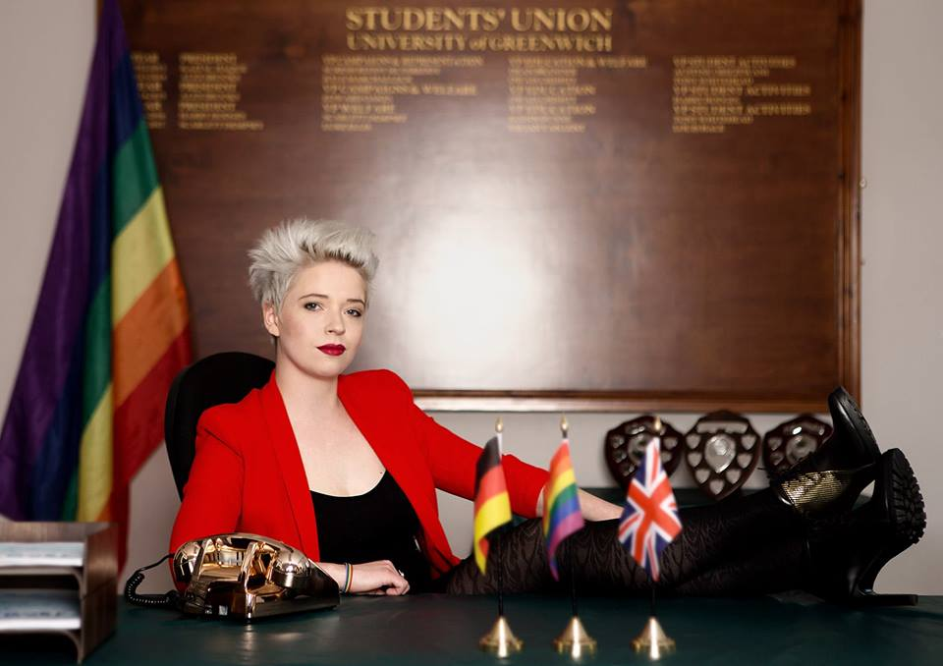
The Role of a Committee
Tricks of an exceptional committee
Communicate with each other
Regular Meetings
Clear notes/updates sent to committee AND members
Create communication channels
Communal Input
Make joint, democratic democratic
Ask for members’ opinions
Empower members
Create feedback opportunities
Tricks of an exceptional committee
Share responsibility
Don’t try to do everything yourselves
Make sure everyone knows the procedures
Utilise your team’s skills
Empower your members
Future-planning & fool-proofing
Keep referring back to your goals/objectives
Measure your ‘progress’
Think about longevity

Slide 9
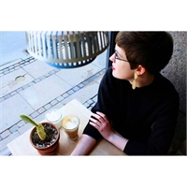
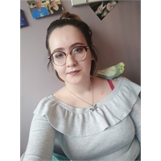
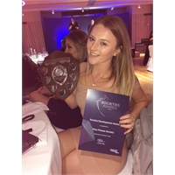
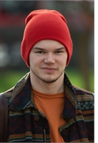
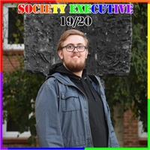
The Role of a Committee
Working with the Societies Exec.
Ryan Bryce
Nele Leitolf
Kate Ridley
Daniel Chedgzoy
Nicole McGrady

Slide 10
The Role of a Committee
Working with the Societies Exec.
The Societies Exec are five dedicated Group Leaders who have been elected to represent you as Society Group Leaders and Society Members.
If you have a problem or an idea, they are your first point of call.
They know the answers! (and if they don’t, they know how to get them)
Not only do they all have fantastic experience of what it’s like to lead a society in Greenwich, they are also incredibly willing to help and advise wherever possible, and love learning more and more about the Societies Section here at GSU!

Slide 11
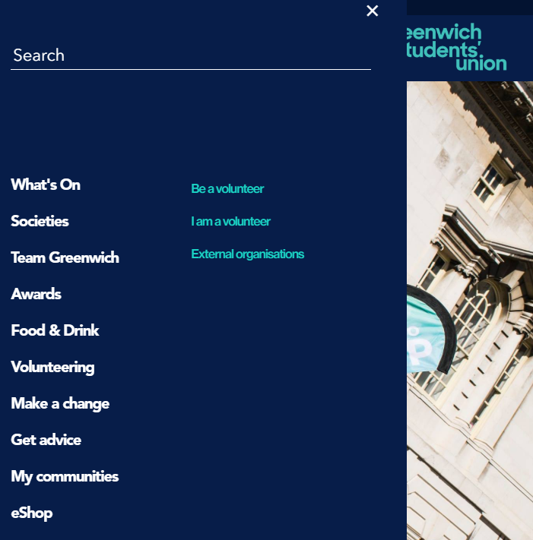
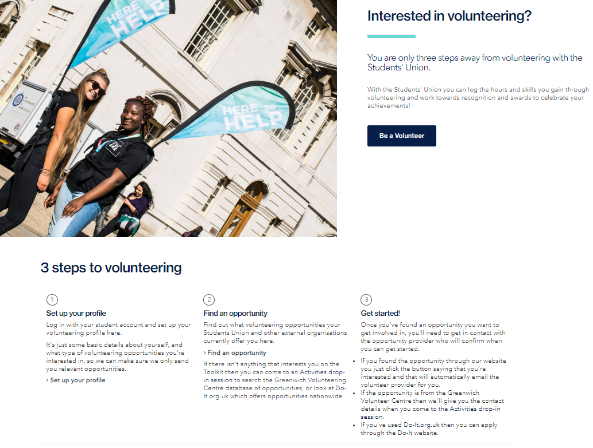
The Role of a Committee
GSCV Volunteering Portal

Slide 12
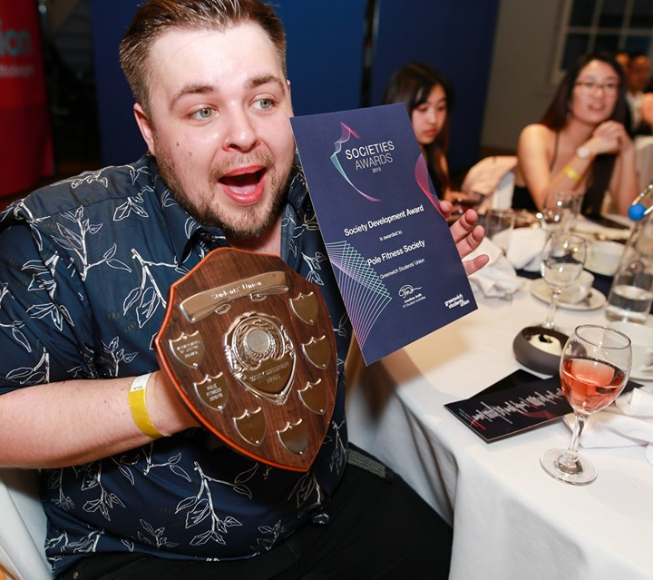
Your Turn: Year Planning

Slide 13
Year Planning
This could be last time your committee are together before September, so let’s get scheming…
SUPERTRIP 2019!!
Meet & Greet
Exam Movie Marathon
New Committee: ASSEMBLE
September
October
November
December
January
February
March
April
May
Welcome Fair
Christmas Party
Valentines Mixer
Halloween Social
Summer Ball
SuperGre Society

Slide 14
Year Planning
This could be last time your committee are together before September, so let’s get scheming…
Make sure to consider:
What are your goals/objectives for the year? What is your vision?
Do you have any year-long projects that you hope to work towards?
What key activities will you be organizing? Does it fit to a timeline?
Are there any groups/organisations you want to collaborate with?
Will you be fundraising/volunteering for any external organisations?
How will I make sure I appeal to a wide-range of students?
How can I ensure students want to take over the Soc next year?

Slide 15
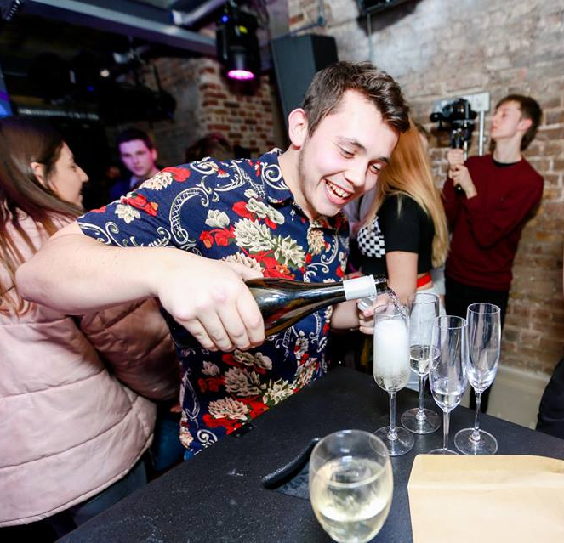
Budget Planning

Slide 16
Budget Planning
How can I raise money for my Society?
Running a Society costs money, and there are four ways that Societies can look to generate the funds to run all their amazing activities.
1. Memberships 2. Fundraising 3. Sponsorships 4. Development Fund

Slide 17
Budget Planning
How can I raise money for my Society?
These should be your primary source of income
Memberships are the most immediate source of income
If you anticipate spending a lot of money this year, set your membership price accordingly
Consider setting up multiple membership options
GSU staff can change your membership prices on your behalf
Students can pay their memberships through the SU website or through our SU receptions
Do NOT collect membership money yourself
Memberships
Fundraising can come in a variety of forms…
Product sales
Ticket sales
Fundraising events
Bake sales
Open mic nights
Pies in the face
RANDOM FUN THINGS
Fundraising is a way of topping up your funds in order to provide greater activities.
Fundraising

Slide 18
Budget Planning
How can I raise money for my Society?
Sponsorships are a great option to raise some funds, and present new opportunities to your Society members. They can help with:
Financial income
Attracting members
Raising your profile
Career prospects
They can be hard work, but they’re worth it.
Sponsorships
The Development Fund is available to student groups requiring help with the delivery of an activity that aids the professional/personal development of their members.
Last year, this helped to cover activities like SHAG Week, Snowsports taster sessions, essential equipment, and inter-university collaborations.
It is evaluated by the Societies Exec, and judged on a case-by-case basis.
Development
Fund

Slide 19
Budget Planning
Managing your money!
Did you know…
Greenwich Students’ Union is a charity!
The money that GSU makes goes back into the organisation – contributing to the funding that we can provide our sports clubs and societies.
Because of this, it is imperative that money is spent appropriately.
That includes money raised/spent by our groups.

Slide 20
Budget Planning
SuperGre Society
BUDGET PLAN:
£4725 - £50 = £4675
Membership: £10
SUPERTRIP 2019: £50 tickets
Christmas Party: £5 tickets
Summer Ball: £20 ticket
TOTAL: £85 (x45 = £3825) Need to raise: £950

Slide 21
Budget Planning
How can I spend my $$$??
There are three ways that Societies can spend their funding – all of which comes from the Society’s internal GSU account. This is where the Treasurer plays a big roll.
1. Invoice 2. Credit Card 3. Claim Form

Slide 22
Budget Planning
Finance Tracking
We will endeavour to send each Student Group a regular financial update.
HOWEVER!
The committee should be able to predict the most accurate estimate at any one time.
Check your Sales Reports, track your expenditure, and keep a record.
Update your budget regularly, and use it to plan for future years.

Slide 23
Budget Planning
Some general financey info…
Finance payments are made once a fortnight
Please give us advanced warning of all significant purchases
Group Funds must NOT be spent on alcohol
Don’t feel pressure to save money for a rainy day – your main objective is to give all members great value for money THIS YEAR.

Slide 24
Managing Risk

Slide 25
Managing Risk
Scenario…
You’re dancing your butt off at one of Hispanic Society’s salsa classes.
It’s so popular that you don’t quite have enough space to boogie.
You get so into the music, that you end up forgetting where you are and cha-cha straight into a pillar.
Well, GSU are liable for the damage, if there is evidence that we haven’t assessed the risk, and reduced it accordingly.
Same thing goes if a Society ends up giving all of our student data over to the mafia. If it was one of our student groups, we’re still liable.
Notes:
Members are your stakeholders.

Slide 26
Managing Risk
GREAT NEWS!!!
A number of regular activities have already been risk assessed:
Room Bookings (where activity fits primary room purpose)
Stalls
Bake Sales (though, you still need to provide allergy info)
Sports Fixtures
PLUS – over the Summer, we’re working on creating a wide-range of templates to make things even more straightforward for you!

Slide 27
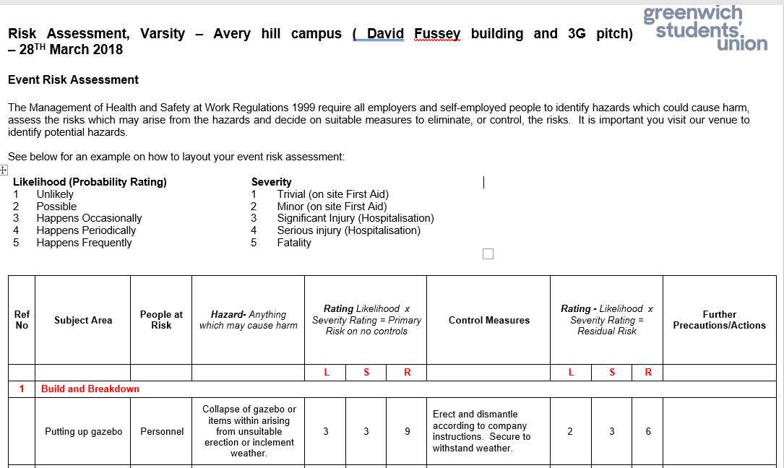
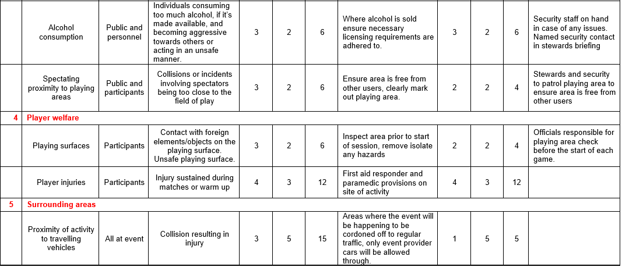
Managing Risk

Slide 28
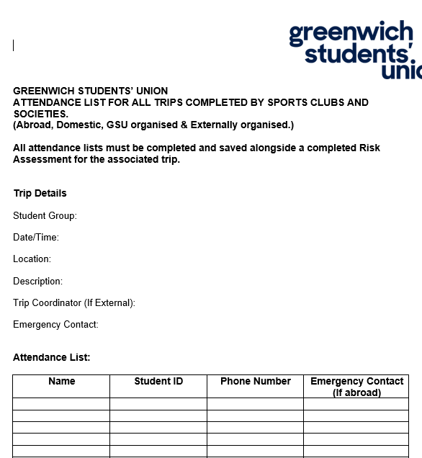
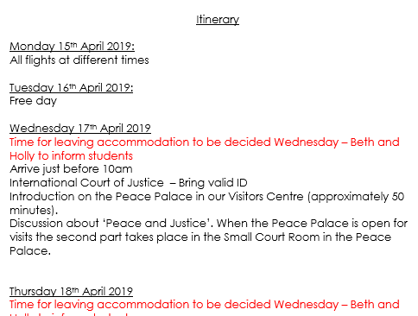
Managing Risk
TRIP ATTENDANCE LIST
ITINERARY

Slide 29
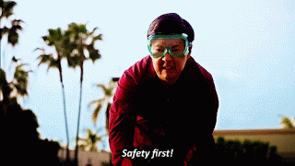
Managing Risk
In the meantime, how can I ensure my society is risk assessed?
Some H&S Top Tips:
Send your risk assessment to participants in advance
Provide an induction to novice members
Put a set of rules/guidelines in place
Review your Activities & RAs regularly
If you’re unsure, google it.
If google can’t help, ask us!!

Slide 30
Managing Risk
In the meantime, how can I ensure my society is risk assessed?
Events with alcohol consumption
The consumption of alcohol can be a high-risk activity, and a contributing factor to many medical emergencies, ill behaviour and damage.
If you are organising an event where alcohol is provided, you must mention this in your Risk Assessment, and inform us accordingly.
To ensure damage is limited, a member(s) of the committee should place themselves in a responsible (sober) position throughout the event
Please remember, that at no time should a student feel pressurised into drinking – allegations of such behaviour at a society-organized event may result in disciplinary actions.
Let’s not forget, not all members of your group will consume alcohol – a lot of UoG Students don’t - and many more will not do so in excess.
Holding alcoholic socials is totally fine, but be mindful that consistently doing this can be rather off-putting for students.
And once again, alcohol will not be funded from a Society’s own funding.

Slide 31
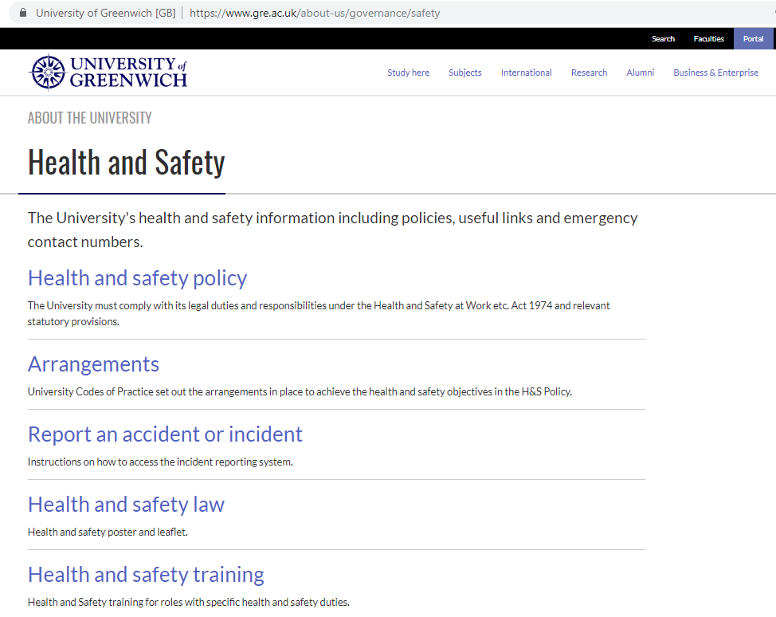
Managing Risk
In the event something goes wrong, please make sure to:
Let us know!
Report it via the Student Portal on the UoG Website!!!
https://www.gre.ac.uk/about-us/governance/safety

Slide 32
How to contact us:
Email Phone
activities@gre.ac.uk Dreadnought: 020 8331 7629 j.rossnelson@gre.ac.uk Avery Hill: 020 8331 9596
p.pabla@gre.ac.uk FaceyB – Society Group Leaders 2019/20 https://www.facebook.com/groups/299161734306336/
How to contact us:
Or
Just come and say hello!!
We’re based in Dreadnought aaaalllllll Summer Monday-Friday 9am-5pm

