Slide 1
Next Steps
Group Leaders’ Conference 2019

Slide 2
Welcome Fairs

Slide 3
When?
Avery Hill - 17th September
Greenwich - 20th September
DOS
Be super engaging
Make it eye-catching
Collaborate with others
Use social media
Staff your stall well
DONTS
Rely on Wi-Fi
Drink alcohol
Stand behind your stall
Be to forceful
Over complicate things
Welcome Fairs
Remember Welcome isn’t just about the fairs. Welcome has a whole program including events and meet & greets!
You will be given plenty of notice over the Summer about reserving your space at our Welcome Fairs – and this will come with plenty more information to. Be aware, there are limited spaces – and we will have to set deadlines accordingly. Missing deadlines will only detriment your group.

Slide 4
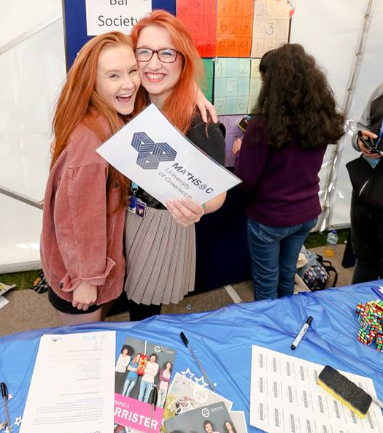
Attracting New Members
It’s pretty simple – the groups that enjoy the most success, have the most fun and get the most out of being a Society or Sports Club are those who pull out all the stops to attract new members.
The challenging part is making that happen.

Slide 5
Attracting Members
Some quick demographics for you…
10% of our GSU students
study @ Medway
Female Students > Male Students
>50% of our GSU students
Identify as BAME
65% of our GSU Students
are non-British
60% of our GSU students
aren’t aged 18-21
>1000 of our GSU students
live at Avery Hill

Slide 6
Attracting Members
Incredibly important to think about how you can make your activities as inclusive as possible.
Approximately 600 students who attended last years’ Welcome Fairs, and registered their interest in at least 1 group, DIDN’T purchase a membership.
(For reference, we’ve had just over 600 paid sports members this academic year.)

Slide 7
Attracting Members
What can you do to make sure your group is as inclusive as possible?
Increase the number of taster sessions you run
Consider appointing a ‘Welcome Sec’ to help reach out to students
Look to collaborate early on with other student groups, with a different reach
Organise and advertise non-alcoholic activities
Work with SU staff and Officers to target-promote your group
Run events at more accessible and convenient times of the day
Encourage your members to run their own events and activities

Slide 8
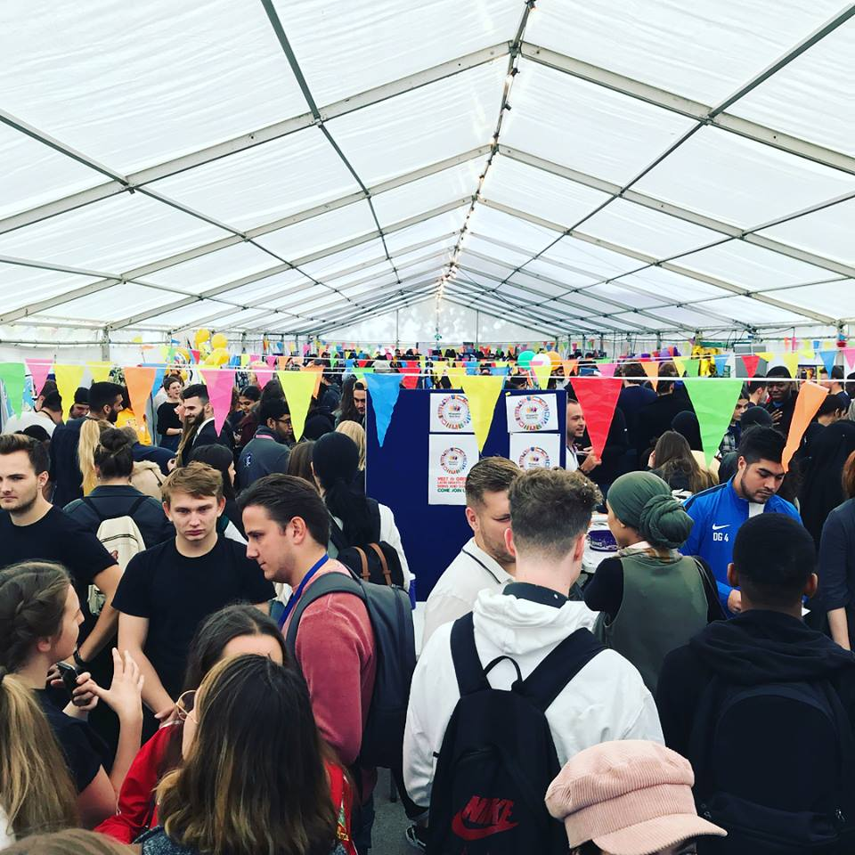
Planning Ahead

Slide 9
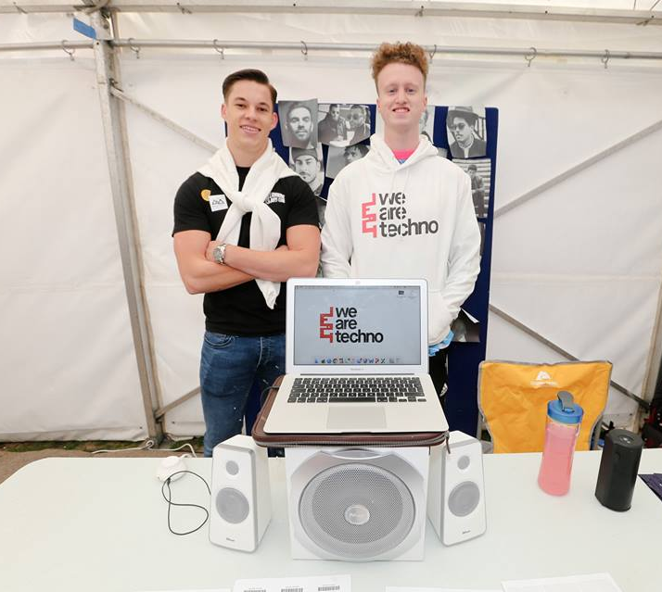
Planning Ahead
What can you do over Summer to prepare for the next academic year?
Update your Website / Social Media
It is essential that you have updated your respective GSU website and your Social media platforms!
Why?
Out of date Social Media is ridiculously off-putting
How will students find/contact you if your information is wrong
Across the year, and particularly through Welcome period, the website is an immediate go-to for students to find out what’s going, and how to get involved in it

Slide 10
Planning Ahead
What can you do over Summer to prepare for the next academic year?
Update your Website / Social Media
This year, the Societies page has had over 36,000 views (5% of the entire website). What’s On had over 17,000, Welcome & Events jointly had 24,000, and Team Greenwich had over 8000.
Between A-Level Results Day and end of Welcome… Socs & Sports had over 25,000 views alone. 2000 straights to Socs!
In that same time period, the Rugby Boat Party had over 4000!!! It was the 10th most visited page. There was a month long period where more students visited this than Team Greenwich.

Slide 11
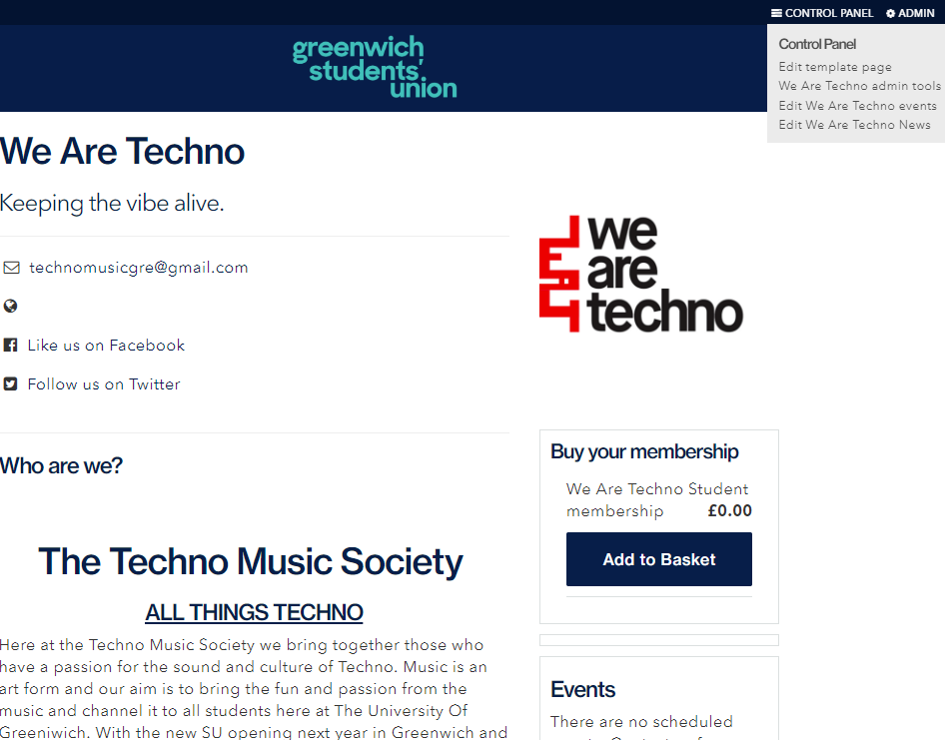
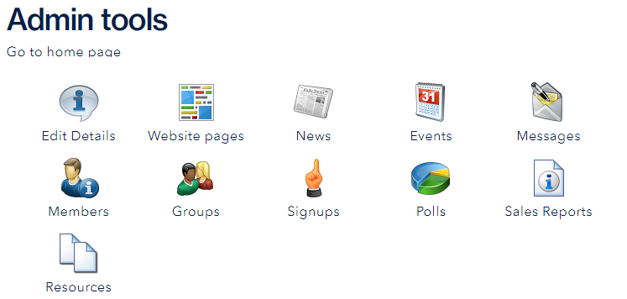
Planning Ahead

Slide 12
Planning Ahead
What can you do over Summer to prepare for the next academic year?
Update your Website / Social Media
Begin Term 1 Planning (regularly revisit your Year Plan)
Make sure committees have fully handed over
Get thinking about your sponsorships
Start discussing your budget for the year
Bounce around ideas on how to make your Welcome Fair stall stand out.

