Slide 1
Marketing 101
James Dix
Marketing and Communications Manager
Greenwich Students’ Union

Slide 2
Marketing 101
Aim: | To support student group leaders with marketing at Greenwich Students’ Union
Objective one: | To inform student group leaders of resources available
Objective two: | To offer an insight into different platforms of communication resources
Objective three: | To demonstrate good practice of social media
Session Outline
Marketing and brand
The right content for the right platform
Platforms at Greenwich Students’ Union

Slide 3
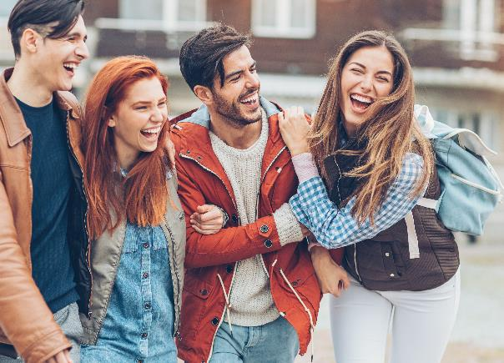
Marketing 101
Marketing and Brand
Branding expectations:
Representation of Union values
Up to date branding
Clear information about sessions/fixtures
Relevant and relatable content

Slide 4
Marketing 101
Good Brand
Has a core colour scheme
Font style relates to activity
Informative
Recognisable

Slide 5
Marketing 101
Bad Branding
Hard to read text
Distasteful messaging
Imagery is abstract rather than focused on image trying to promote

Slide 6
Expectations for August 15

Slide 7
Marketing 101
What platforms can you use to promote your group?
Digital
Social media – posting to feed/timeline/live video
Social media – direct targeting e.g. DM/IM
Digital screens around University & Union
Email
Union channels
Physical
Face to face communication
Posters (some areas of the University)
Flyering
Promotional stall
Events e.g. taster sessions

Slide 8
Marketing 101
Quick Guide
Digital
The meme is still massive – use it well
Use the right social media platform for the right message
Facebook mainly used for memes/events/groups (pretty much dead)
Twitter, live updates at an event, a canvas for creating memes
Instagram growing and very strong

Slide 9
Marketing 101
Quick Guide
Physical
Digital Screens – we have a guidelines document
2880px by 1620px (Dreadnought Atrium)
Book a stall or exhibition – gsuroombookings@gre.ac.uk
Submit content to Activities Assistant for newsletter content
Strong welcome presence
Have a meet and greet early
Rep your brand on merch

Slide 10
Marketing 101
GSU Platforms
Activities newsletter
Sent to thousands of students
Goes out every Wednesday
Content & Image
Short and sweet

Slide 11
Marketing 101
GSU Platforms
GSU Events
Platform used for Union events
Users will see welcome events here

Slide 12
Marketing 101
GSU Platforms
GSU Social Media
Tag @Greenwichsu on Instastory
Shareable posts
Send us images directly for us to use

