Slide 1
General Data Protection Regulation

Slide 2
GDPR
General Data Protection Regulation (GDPR)
Replaced previous data protection legislation
New legislation effective from 25th May 2018
Changed how businesses and public sector organisations can handle the information of their customers/members
GDPR is all about…
Transparency, Consent and Compliance

Slide 3
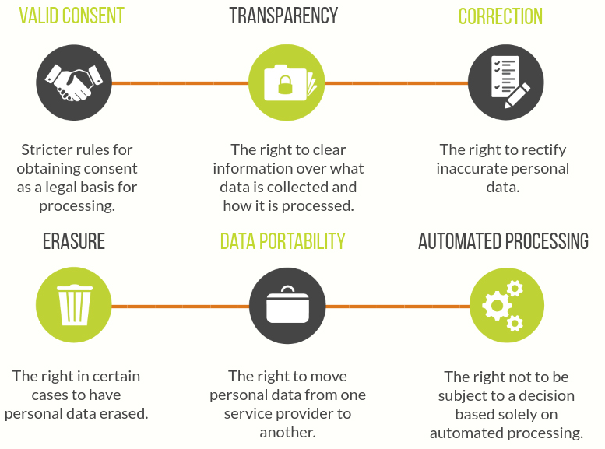
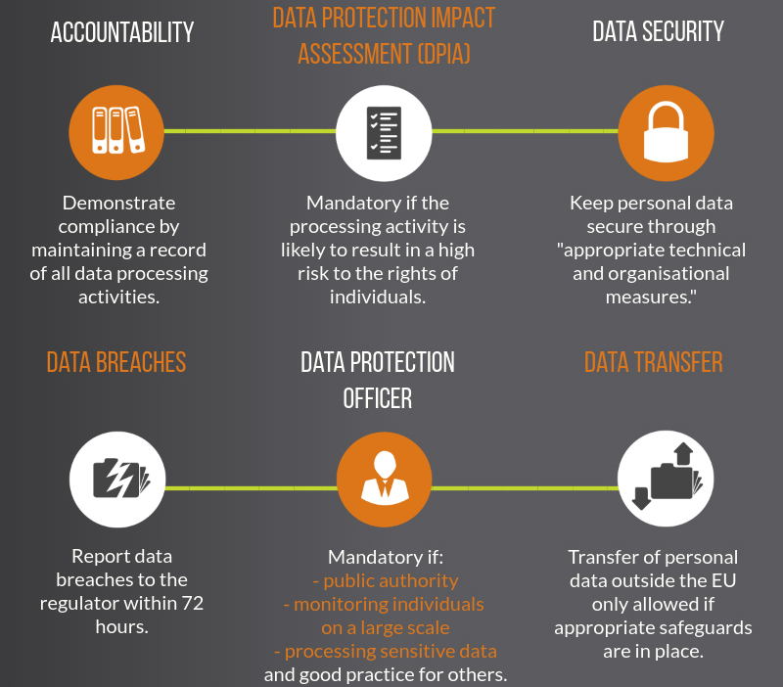
GDPR
For individuals
For organisations
Infographics from www.itgovernance.co.uk

Slide 4
What do we do at the SU
Internal GDPR working group in Union
Have a Data Protection Officer – Head of Marketing and Communications
Linking with other Unions to see what they’re doing
Updated policies and procedure – written by Head of Marketing and Communications
Information for users on our website, e.g. how we’ll use data, privacy notice
Briefing/Training for student group leaders at GLC
Updates to recruitment process and HR – led by Mel, GSU Office Manager
Arrangements with Registry and ILS about data capture in online registration
Ensure suppliers we share data with are compliant, e.g. Privacy Impact Assessment

Slide 5
What do you have to do
Tell students what data you’re going to collect and what you’re going to use it for
Get consent from students to email them about your activities
Verbal consent is fine as long as you document when it was given
It is not a condition of membership
Ensure that all personal information protected at all times e.g. password protecting all documents with special categories, admin levels of access
Any information that can identify someone without their consent
Special categories
Ensure that our members have a right to be forgotten
They can easily remove themselves or you can from any contact lists

Slide 6
Special categories
Or, Sensitive information
Financial/ID information
Racial or ethnic origin
Political opinions
Religious beliefs
Trade union activities
Physical or mental health
Sexual orientation/life
Details of criminal offences
Individuals and organisations need explicit consent to collect this data, and/or fall under other conditions in the GDPR, e.g. employment, legal claims.

Slide 7
You break it, you buy it!
Data breaches MUST be reported within 72 hours to the Union
Data breaches and breaking of legislation comes with heavy fines up to 20 million Euros or 4% of global turnover, whichever is higher
Please be careful with your members’ data!

Slide 8
Messaging through MSL
MSL – Membership Solutions Limited = system used at SU for website and messaging students
Has been GDPR assessed by Union and University – approved for use with students’ data
Can save drafts, see sent messages and track opens
Connects straight to data groups, e.g. membership lists, ticket holder lists – don’t have to create them yourself
Reduces risk of sending messages to the wrong people or exposing people’s contact details unnecessarily
SU staff can support you with any queries

Slide 9
Contacts and information
Staff have GDPR knowledge – can give advice
Look at and share greenwichsu.co.uk/privacy with students if they have any queries
Privacy notices on how we use data
Right to information requests
Reporting data breaches
Email Data Protection Officer (sucompliance@gre.ac.uk)
Student information changes – Portal or Student Centres
Data Protection Officer - Head of Marketing and Communications
Information online at greenwichsu.co.uk/privacy
Questions and issues to sucompliance@gre.ac.uk

