Slide 1
What should we expect from each other?

Slide 2
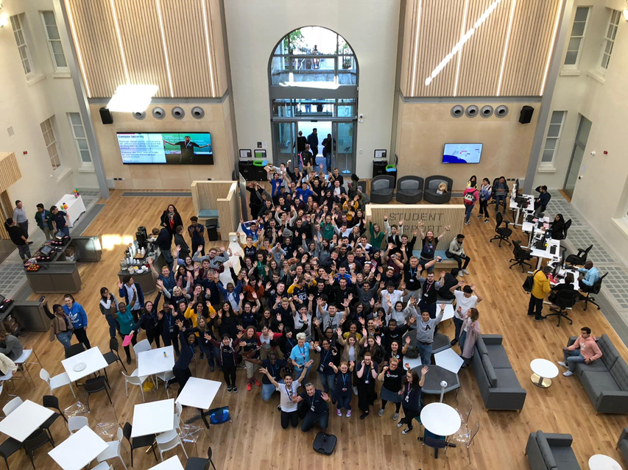
What are we here to do?
GSU
Represent all students to the University
Facilitate representatives
Facilitate student groups
Ensure representatives follow the rules
Provide services such as advice & outlets
Manage charity accounts of groups
Align with charity laws

Slide 3
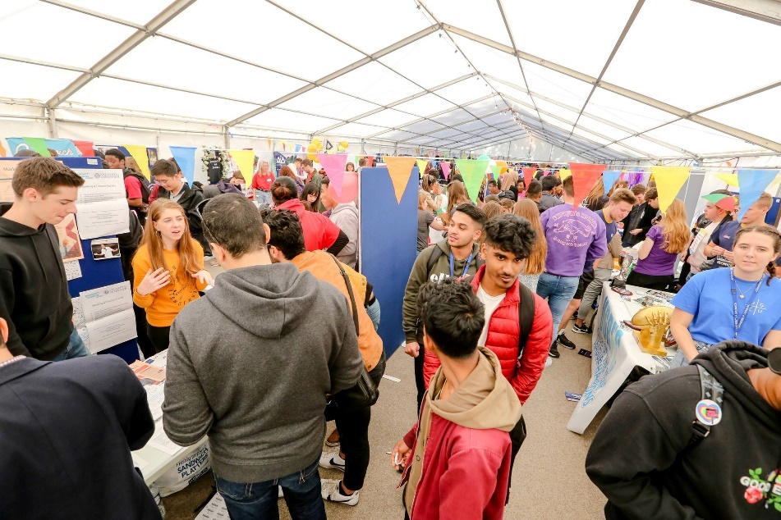
What are we here to do?
STUDENT GROUPS LEADERS
Represent your members to the Union, University and wider public
Facilitate activity for your members
Provide feedback and insights to the union
Make decisions within our democratic structure
Be ambassadors for the Union and University
Have fun!

Slide 4
Requirements?
Fiscally responsible
Follow charity law
Ensure reputation is not harmed
Engage with stakeholders for the benefit of our students
Make sure our services are fit for purpose
Notes:
SU bits

Slide 5
Requirements?
Stick to the rules
Engage with the union
Ensure the welfare of your students during activities
Understanding your role as a representative
Do not bring the Union or University into disrepute
Notes:
Group leaders

Slide 6
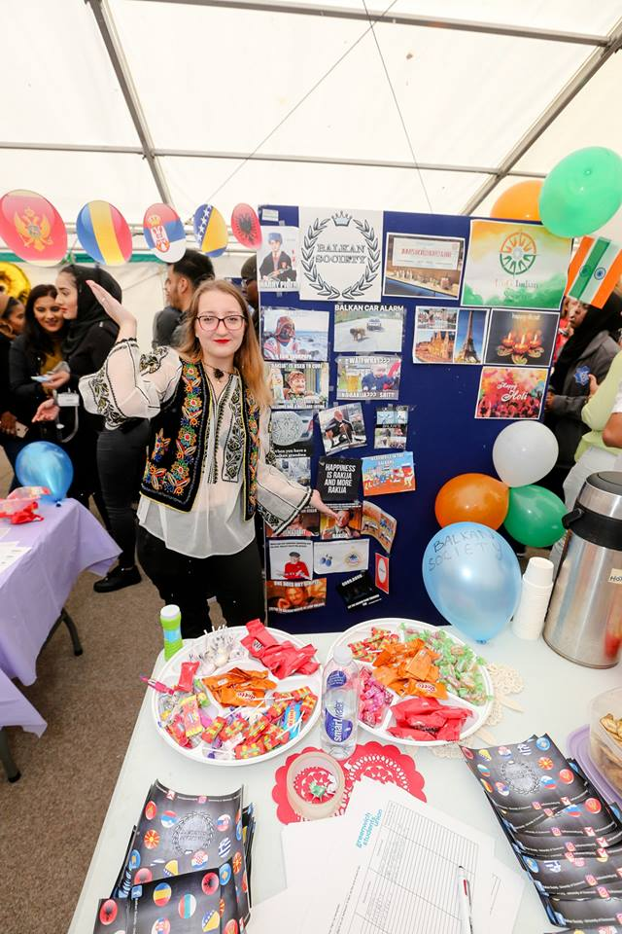
Representatives- when does it count?
Attending event/ bookings hosted by your group on or off campus
Attending trips organised by/through/for your group
Attending official group socials
At all fixtures/ competitions
Events in which you are invited as an SU representative
When undertaking official correspondence specific to your role
When engaging in social media relative to your role (official page/responding as committee member)
Notes:
When groups are representatives- brain storm animation

Slide 7
Behaviours
What stands out in these?
Is this acceptable behaviour?
Are both situations the same? Are they different?
Notes:
Compare and contrast articles- 5 mins
What stands out in these?
Are both situations the same?
Is there anything wrong with these clippings?

Slide 8
Behaviours
Chronicle article - a student describing what happened in his initiation
Mail Online article – From a court case: perpetrators handed prison sentences
Understand how your actions affect others- and how they look
Notes:
Reveal what happened after each article
-perception is everything
- Bullying, harassment, forcing is the issue

Slide 9
What can I do?
Reputationally
Financially
Legally
Just plain stupid
Notes:
Enjoy yourselves to your hearts content, as long as these rule are not broken…

Slide 10
Code of Conduct
Agreement between yourselves and GSU
Applicable to all
Group leaders- required to sign this
Members- will be visible on website and shown before they can purchase membership
Notes:
We will make an agreement-
All rules and requirements in this document

Slide 11
Expectations of GSU ?
Talk to us!
Through your representative streams
You!
Exec
Officers
Notes:
Exec can take your feedback

