Slide 1
Event Planning Session
Priya Pabla
Academic Communities Coordinator
Notes:
Introductions – show of hands, who is sports and who is socs.
My job – to work with the university to get students engaged with things around their course/studies. Such as International Festival, Active GRE and looking after Academic Societies
This session is to give you all the who’s, how’s and what’s that go with putting on any event as a student group. You guys get loads of privileges being a student group as both the SU and the uni give you priority over things like room bookings, giving you the best chance at putting on the best events.
There are a lot of aspects to event planning that need to be considered so this session aims to go through all of these and how everything works at GSU. Hopefully, by the end of the session, you’ll all know exactly who you need to go to and how to find them, so you know what you need to do when it comes to setting up events next year.

Slide 2
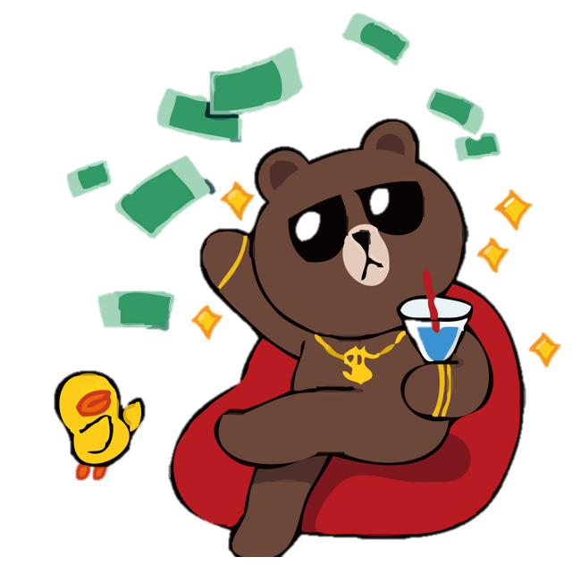
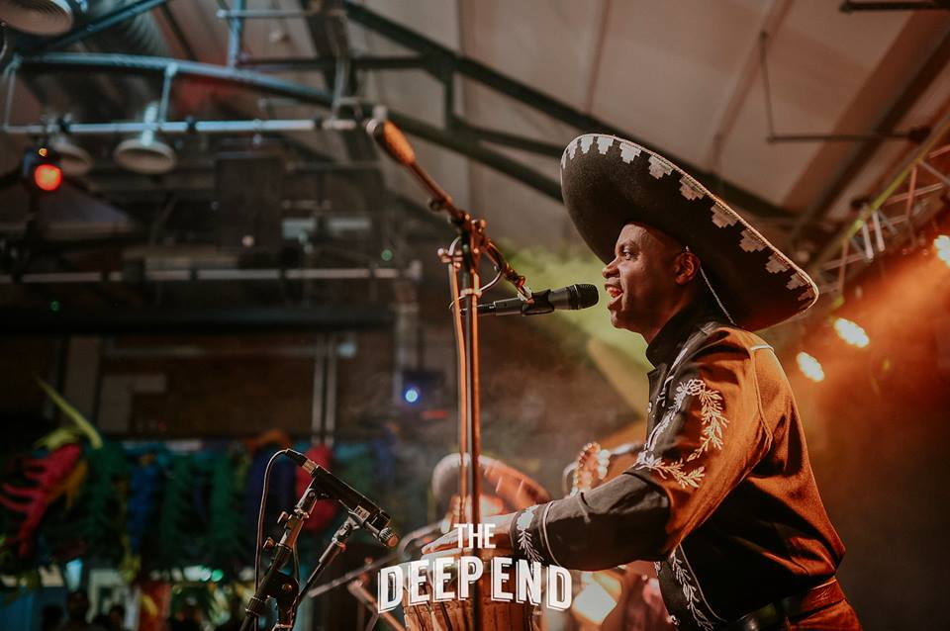
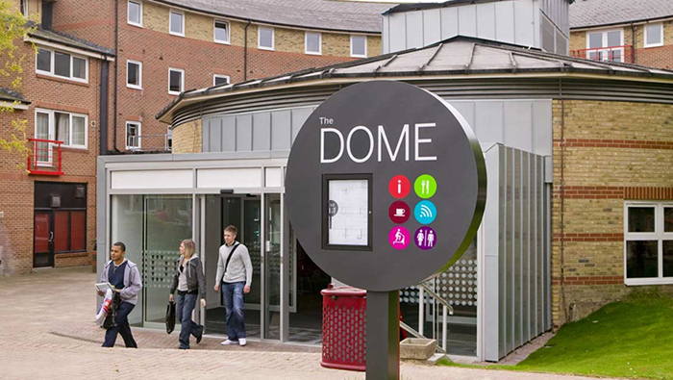
The Planning Timeline – pre-event
Event Concept
Location/room booking
Estimated costs/locating funding
Promo!
Ordering
Guest Speaker checks?
Notes:
Concept: fundraising, social, regular meeting, end of term party, pub quiz,
Costs: funding forms, using your account, how to access (invoice, card, reimbursement). Cost/income sheet
Location: room booking 3 weeks in advance, porters, room booking form. EXTERNAL event needs RA and health and safety checks (trip list)
Guest speaker checks: 3 weeks in advance, explain process
Ordering: give yourself enough time for things to arrive and a time buffer to get last minute things
Promo: use your messaging tool on webpage, social media. Ask James Dix to add things to newsletters and screens (dimensions). Add event to website and ask to set up tickets if needed.

Slide 3
The Planning Timeline – during event
On the day…
Have a plan for the day
Ensure everyone knows how long it’ll take to set up and set down
Staffing plan
Sharing is caring – spread the responsibilities!
Notes:
It’s important that you know who is doing what on the day of the event to make sure you’ve done everything possible to iron out any last-minute bugs.
When booking your room, you would have included the time it takes to set up and clear down the event. Make sure there are committee or helpers in place for this.
Having a staffing plan will help make sure you have everything ready on the day. This also shares out the responsibilities, cause on the day it can get hectic and easy to forget things if you try and do it all on your own.

Slide 4
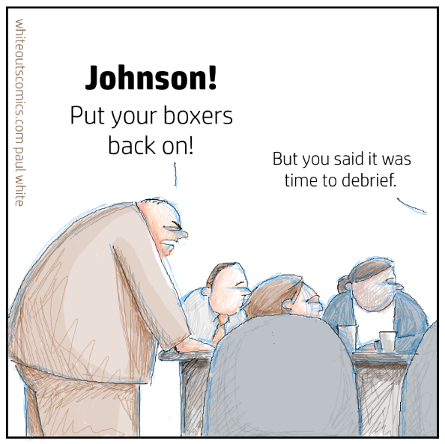
The Planning Timeline – post-event
After the event…
Debrief – what went well, what could be improved
Pictures!
Notes:
Debrief: not necessarily needed when it’s a small social or a regular thing, but mainly for when you organise a big one-off event like an end of term party in Lower Deck or an exhibition.
It’s good to get everything off your chest and see in retrospect, how you thought it all went. This is good for you guys so you know how to improve if you wanna try and do it again, if it’s an annual event, it’ll be good to have notes to give to the new committee who come in. It’s also really helpful for us to see how we can do better or improve our processes.
Also, we love pictures of everything you do – so send them over to us to share share share!

Slide 5
Resources
Funding pots
Generated income accounts
Community Ambassadors
Activities Store Room
GSU Marketing team
GSU Staff (Justina, Matt, Activities team…)
Notes:
You need to be aware of all of the resources you have as a student group as this will answer a lot of questions you might have when planning an event.
A main resource is money. You have a few ways of accessing this. One is your generated account, which has all money generated by memberships and other income (e.g. fundraising). This account is for you to use to pay for anything your group does throughout the year. Your treasurer is in charge of looking after all finances and making sure you don’t overspend.
There are also some funding pots that you can apply to for extra funding for an event. All students groups have access to the Activities Development Fund. The clue’s in the name with this one, it’s mainly for developing what your group is set out to achieve. Development comes in the form of offering an improved event to ones you’ve put on before, to encourage more people to join and to show a long-term benefit to the society or club.
Another pot of funding is the Academic Communities Funding. This is a pot of funding mainly for academic societies, so their applications will be prioritised, but depending on the type and point of the event, it could be opened to others to apply for. This funding is for events/projects that engage members/students in community building activity and try to engage with students who don’t traditionally get involved with SU stuff. You could also collaborate with academic societies to put on a joint event.
Community Ambassadors: Another resource to come from Academic Communities is actual man-power help. CA’s are there to offer you a hand with your project or event, whether it’s helping to put up décor, man the guest list at the door… whatever you need! We have CA’s on all 3 campuses.
Activities Store Room: Sometimes it’s hard to stuff all of your orders in your room at home. We know groups have a lot of things (equipment for sports) so we have a trusty store room in Dreadnought, where there is a small space for each student group to keep some of their stuff until they need it.
Marketing Team: the GSU marketing team keep tabs on all our social medias, and also newsletters that go to all our members. Always asking for content for this so send it their way. They can also put stuff up on the screens, you just need to have the dimensions.
GSU staff: we’re a fountain of knowledge – use it! Should you have questions about tech or room bookings or Lower Deck, you can just pop in and ask as we are here to help you with your events.

Slide 6
To Recap…
Timing is
Keep the communication going
Have your finances on
If you don’t know, just ask
Notes:
The main things to take from this, alongside the actual process are summarised in 4 points.
Timing: Time management is a skill that you will improve as a committee member as event planning forces you to make sure you have things booked and ordered with time to spare. If you keep on top of this, running events shouldn’t add too much extra pressure to your day-to-day.
Communication: things start to breakdown if there’s a lack of communication between committee members and also between us and the committee. If something’s not going right, tell us and we can figure out how to sort it out before it’s too late (e.g. if your order hasn’t arrived yet). Share everything you’re doing with at least one other person so in case you’re ill or can’t be there, someone else can take over and still know what’s happening.
Finance: it’s so important to keep on top of what you’re spending. Overspending means having to make the money back somehow before the end of the year which is a pain. You have an idea of how much money you’re bringing in and how much things are going to spend. Have a spreadsheet or some kind of document to keep track of everything.
Ask: We are all here, being paid, to support you. Students groups and held so highly in the eyes of the SU and the university. They love seeing what you achieve so of course we’re here to help answer all questions you have, no matter how small.

